Slide 1
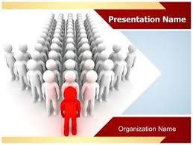
LEADERSHIP MANAGEMENT
By : dr. Ibtisam Merghani Oman
MBBS, DPH , MPH,MD

Slide 2
Objectives
By the end of this session the student will be able to:
Define leader& leadership
Differentiate between leadership and management

Slide 3
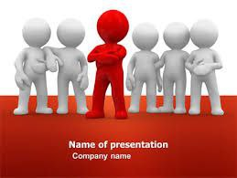
Definition of a leader
An individual who is able to influence and inspire a group or organizational members to help the group or organization achieve its goals.

Slide 4

Definition of a leadership
Leadership is a process whereby an individual influences a group of individuals to achieve a common goal.
Leadership is a function of a leader, the followers, and the situation in striving to achieve a common purpose or goal.

Slide 5
Leadership vs. Management
Managers cope with complexity.
Managers plan and budget.
Managers organize the staff.
Managers control and problem –solve.
Leader cope with change.
Leaders set directions and share values.
Leaders align people with the organization and therefore empower them.
Leaders motivate people, including through networks of informal relationships.
Leaders
Managers

Slide 6
“Not all leaders are managers, nor are all managers leaders”

Slide 7
Managing vs. Leading
Managers
Administer
Maintain
Control
Short-term view
Ask how and when
Initiate
Do things right
Leaders
Innovate
Develop
Inspire
Long-term view
Ask what and why
Originate
Do the right things

Slide 8
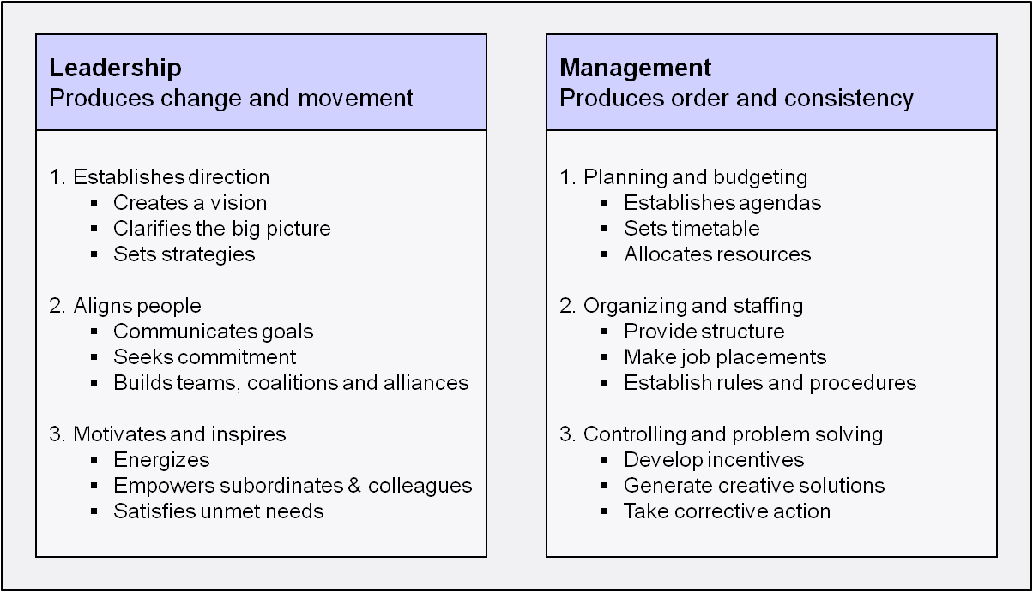
LEADERS VERSUS MANAGERS – cont.

Slide 9
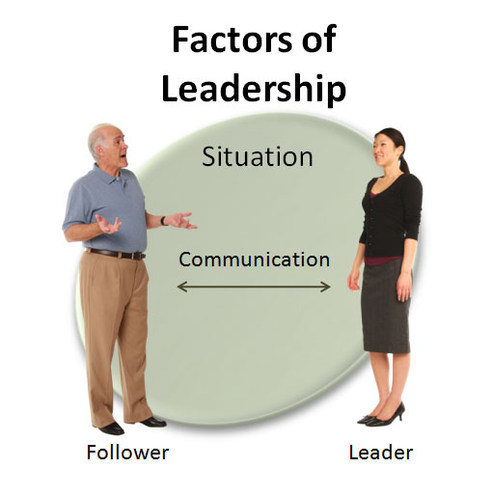
FOUR FACTORS OF LEADERSHIP

Slide 10
LEADERSHIP THEORY
GREAT MAN THEORIES
Leaders are exceptional people, born with innate qualities, destined to lead.
Term 'man' was intentional - concept was primarily male, military and Western.
TRAIT THEORIES
Research on traits or qualities associated with leadership are numerous
Traits are hard to measure. For example, how do we measure honesty or integrity?

Slide 11
LEADERSHIP TRAITS AND SKILLS
TRAITS
Adaptable to situations
Alert to social environment
Cooperative
Decisive
Dependable
Dominant (desire to influence others)
Energetic (high activity level)
Persistent
Self-confident
Tolerant of stress
Willing to assume responsibility
SKILLS
Clever (intelligent)
Conceptually skilled
Creative
Diplomatic and tactful
Fluent in speaking
Knowledgeable about group task
Organised (administrative ability)
Persuasive
Socially skilled.

Slide 12
LEADERSHIP THEORY – cont.
FUNCTIONAL THEORIES
Leader is concerned with the interaction of 3 areas:
Task – goal setting, methods and process.
Team – effective interaction/communication, clarify roles, team morale.
Individual – attention to behaviour, feelings, coaching.

Slide 13
LEADERSHIP THEORY – cont.
BEHAVIOURIST THEORIES
Leaders behaviour and actions, rather than their traits and skills e.g. production orientated or people orientated.
Different leadership behaviours categorised as ‘leadership styles’ e.g. persuasive, consultative, democratic.

Slide 14
LEADERSHIP THEORY – cont.
TRANSFORMATIONAL THEORIES
Leaders inspire individuals, develop trust, and encourage creativity and personal growth
Individuals develop a sense of purpose to benefit the group, organisation or society. This goes beyond their own self-interests and an exchange of rewards or recognition for effort or loyalty

Slide 15
Quality of good leaders
Visionary and forward-looking
Must be adaptable and change with changing circumstances
Must be honest and sincere of purpose
Able to see things in perspective
Diplomatic and humble
Must be self-confident
Must have sense of humour
Must listen to his subordinates

Slide 16


Slide 17

A
ARIGATO
Thank you

